Slide 1
Functions
Computer Science, Purdue University
Copyright McGraw Hill, Rosen, Discrete Mathematics and its Applications

Slide 2
Functions
Basic Definitions
Definition: Let A and B be nonempty sets. A function f from A to B, denoted f: A → B is an assignment of each element of A to exactly one element of B. We write f(a) = b if b is the unique element of B assigned by the function f to the element a of A.
Functions are sometimes called mappings or transformations.
Students
Grades
A
Carlota Rodriguez
B
Sandeep Patel
C
Jalen Williams
D
F
Kathy Scott
Computer Science, Purdue University

Slide 3
Functions
Basic Definitions
A function f: A → B can also be defined as a subset of A×B (a relation). This subset is restricted to be a relation where no two elements of the relation have the same first element.
Specifically, a function f from A to B contains one, and only one ordered pair (a, b) for every element a∈ A.
and
Computer Science, Purdue University

Slide 4
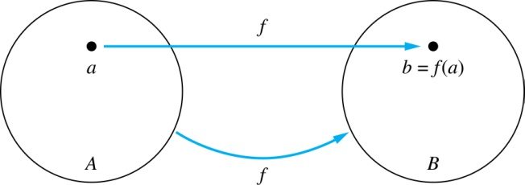
Functions
Basic Definitions
Given a function f: A → B:
We say f maps A to B or
f is a mapping from A to B.
A is called the domain of f.
B is called the codomain of f.
If f(a) = b, then b is called the image of a under f.
a is called the preimage of b.
The range of f is the set of all images of points in A under f. We denote it by f(A).
Two functions are equal when they have the same domain, the same codomain and map each element of the domain to the same element of the codomain.
Computer Science, Purdue University

Slide 5
Functions
Representing Functions
Functions may be specified in different ways:
An explicit statement of the assignment.
Students and grades, for example.
A formula.
f(x) = x + 1
A computer program.
A Java program that when given an integer n, produces the nth Fibonacci Number.
Computer Science, Purdue University

Slide 6
Functions
Some Examples
z
A
B
f(a) = ?
The image of d is ?
z
a
The domain of f is ?
A
x
The codomain of f is ?
B
b
y
The preimage of y is ?
b
c
f(A) = ?
{y,z}
d
z
The preimage(s) of z is (are) ?
{a,c,d}
Computer Science, Purdue University

Slide 7
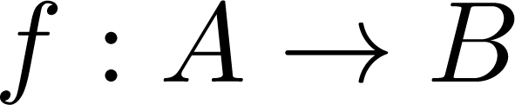
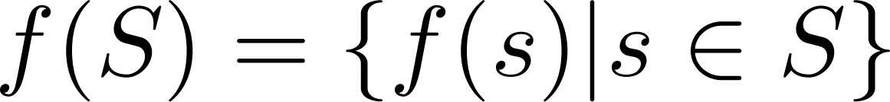
Functions
Some Examples
If and S is a subset of A, then
A
B
a
{y,z}
f {a,b,c,} is ?
x
{z}
b
f {c,d} is ?
y
c
d
z
Computer Science, Purdue University

Slide 8
Functions
Injections
Definition: A function f is said to be one-to-one , or injective, if and only if f(a) = f(b) implies that a = b for all a and b in the domain of f. A function is said to be an injection if it is one-to-one.
A
B
a
x
v
b
y
c
z
d
w
Computer Science, Purdue University

Slide 9


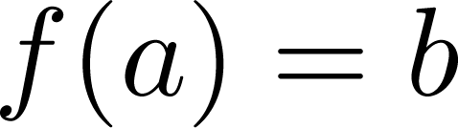
Functions
Surjection
Definition: A function f from A to B is called onto or surjective, if and only if for every element there is an element with . A function f is called a surjection if it is onto.
A
B
a
x
b
y
c
z
d
Computer Science, Purdue University

Slide 10
Functions
Bijection
A
B
Definition: A function f is a one-to-one correspondence, or a bijection, if it is both one-to-one and onto (surjective and injective).
a
x
b
y
c
d
z
w
Computer Science, Purdue University

Slide 11
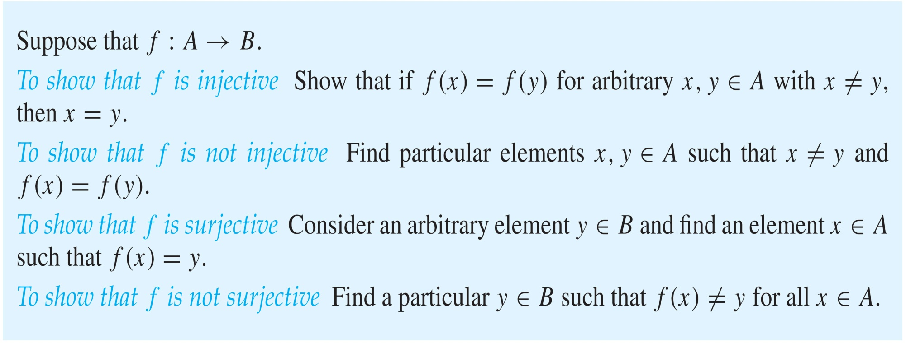
Functions
Showing that a Function is One-to-one or Onto
Computer Science, Purdue University

Slide 12
Functions
Showing that a Set is One-to-one or Onto
Example 1: Let f be the function from {a,b,c,d} to {1,2,3} defined by f(a) = 3, f(b) = 2, f(c) = 1, and f(d) = 3. Is f an onto function?
Solution: Yes, f is onto since all three elements of the codomain are images of elements in the domain. If the codomain were changed to {1,2,3,4}, f would not be onto.
Example 2: Is the function f(x) = x² from the set of integers to the set of integers onto?
Solution: No, f is not onto because there is no integer x with x² = −1, for example.
Computer Science, Purdue University

Slide 13
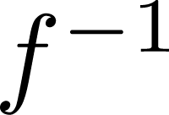
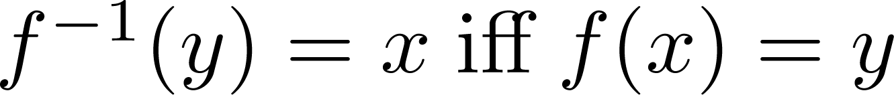
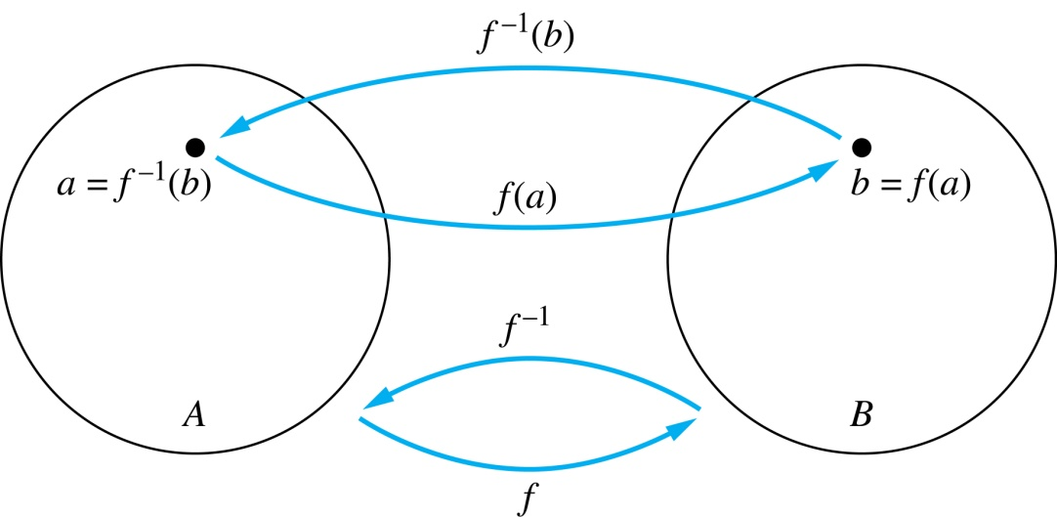
Functions
Inverse Functions
Definition: Let f be a bijection from A to B. Then the inverse of f, denoted , is the function from B to A defined as
No inverse exists unless f is a bijection. Why?
Computer Science, Purdue University

Slide 14
Functions
Inverse Functions
A
B
A
B
f
a
V
V
a
b
b
W
W
c
c
d
X
X
d
Y
Y
Computer Science, Purdue University

Slide 15
Functions
Inverse Functions: Examples
Example 1: Let f be the function from {a,b,c} to {1,2,3} such that f(a) = 2, f(b) = 3, and f(c) = 1. Is f invertible and if so what is its inverse?
Solution: The function f is invertible because it is a one-to-one correspondence. The inverse function f⁻¹ reverses the correspondence given by f, so f⁻¹ (1) = c, f⁻¹ (2) = a, and f⁻¹ (3) = b.
Computer Science, Purdue University

Slide 16
Functions
Inverse Functions: Examples
Example 2: Let f: Z → Z be such that f(x) = x + 1. Is f invertible, and if so, what is its inverse?
Solution: The function f is invertible because it is a one-to-one correspondence. The inverse function f⁻¹ reverses the correspondence so f⁻¹ (y) = y – 1.
Computer Science, Purdue University

Slide 17
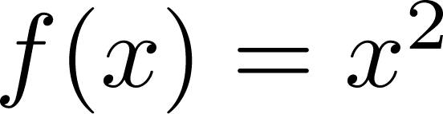
Functions
Inverse Functions: Examples
Example 3: Let f: R → R be such that . Is f invertible, and if so, what is its inverse?
Solution: The function f is not invertible because it is not one-to-one .
Computer Science, Purdue University

Slide 18
Thank You

